Slide 1
Springworks Farm Preliminary Study
Windham Packaging, LLC
Gabriela Hernandez

Slide 2
Summary and Conclusions
Weight loss was negligible in all samples (<0.01%) throughout the entire study
In all green leaf and baby romaine samples, headspace O2 levels were close to ambient (18-20%O2), while CO2 levels generally ranged from 1-2%; ambient CO2 is less than 0.1%.
There were no major differences between samples kept inside the cartons and outside the cartons suggesting that the amount of venting in the cartons was adequate to get cooling.
Browning in the stem was noticed on Day 0 and increased significantly by day 7. In the next study, a mixture of ascorbic and citric acid should be sprayed onto the butt end of the green leaf and baby romaine heads to see if browning is controlled.
On days 7, 9, and 17, there were no significant differences in temperatures between samples inside and outside the carton.
On days 12 and 14, temperatures of green leaf inside the carton was higher than those outside of carton.
Temperature remained high in green leaf and baby romaine samples throughout the study. We recommend reducing the number of days stored at 50°F, as it is likely that the product will be kept at 50°F for much less than 7 days in a real-life setting.
Except for the pink butt ends and the occasional defects on the outside leaves, which occurred more in the larger weight 8-oz heads than the smaller weights, the green leaf lettuce held up very well for 17 days at the temperatures that were studied. We think that mechanical damage occurred to the 8-oz heads because the bag (sleeve) was too tight.

Slide 3
Summary and Conclusions
Bag sizing:
3-ct Baby Romaine will need a length of 9” (includes 2” header with handle)
1-ct Green Leaf (5-7 oz) will use the small sleeve
14.5” L from bottom seal, 10.125” across the top
The baby romaine study was cut short because of extensive browning and mildew. We have decreased the O₂ flux for the current trial to see if we can extend shelf life. An antibrowning spray should also help with extending shelf life.

Slide 4
Results and Discussion:
Internal Temperature
Visual Quality Throughout Shelf Life
Photos
Visual Comparisons and Presence of Defects among Samples
Shelf Life Studies

Slide 5
Internal Temperature
Days in Storage | Sample | Temperature (while inside bag) | Temperature (Removed from bag)
7 | Green Leaf no Carton | 57.5 | Not Taken
7 | Green Leaf in Carton | 55.1 | Not Taken
7 | Romaine no Carton | 53.8 | Not Taken
7 | Romaine in Carton | 53.7 | Not Taken
9 | Green Leaf no Carton | 55.2 | Not Taken
9 | Green Leaf in Carton | 54.2 | Not Taken
9 | Romaine no Carton | 56.2 | Not Taken
9 | Romaine in Carton | 55.8 | Not Taken
12 | Green Leaf no Carton | 57.2 | 64.4
12 | Green Leaf in Carton | 60.0 | 58.8
14 | Green Leaf no Carton | 55.8 | 61.9
14 | Green Leaf in Carton | 61.1 | 64.8
17 | Green Leaf no Carton | 51.2 | 59.5
17 | Green Leaf in Carton | 51.5 | 61.0

Slide 6
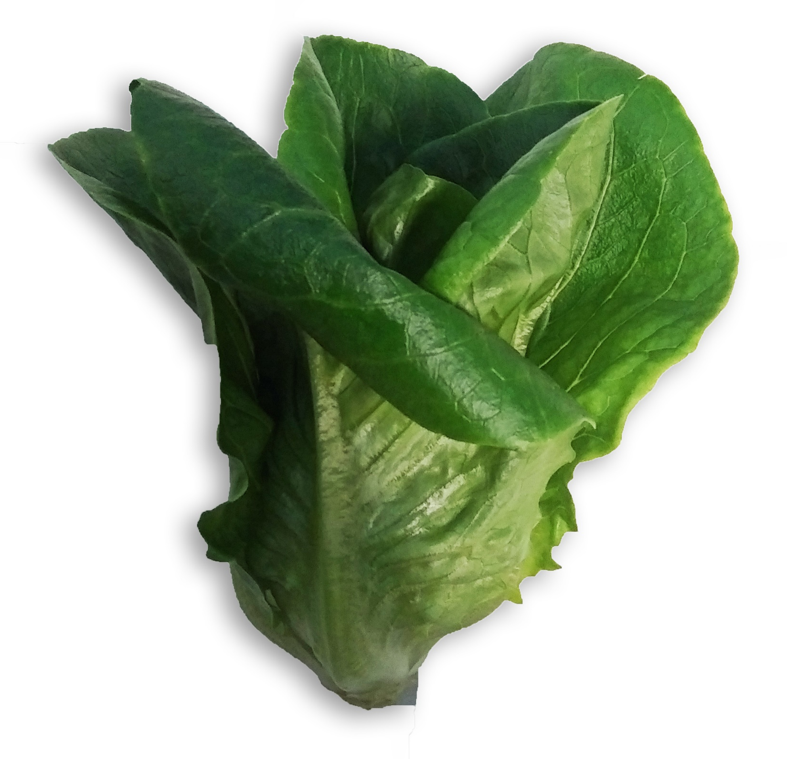
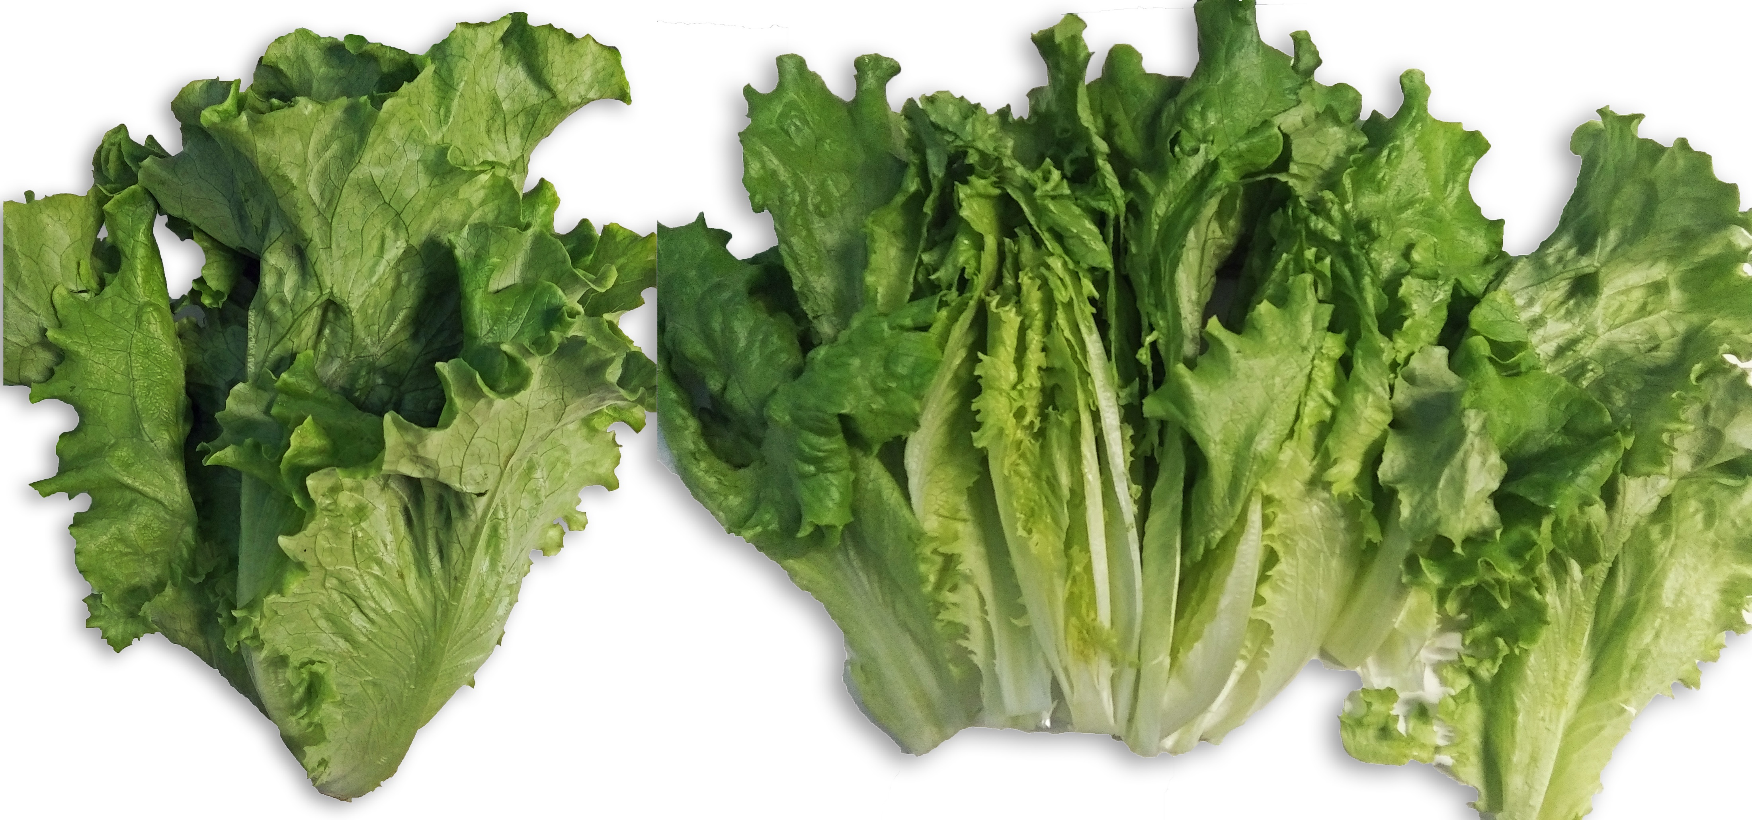
Visual Quality and Taste
Day 0: Green leaf lettuce and baby romaine were harvested and packaged at Springworks farm. Samples were placed in coolers and transported to the labs at Windham Packaging.
Initial quality:
Green leaf
Leaves were green and crisp with no signs of mildew.
No tip burn visible
No spotting or wilting
Taste was fresh, no smell
Baby Romaine
Leaves were green and crisp
No signs of mildew
Slight tip burn on a couple of exterior leaves
Taste is fresh
Initial Baby Romaine (top) and Green Leaf (bottom)

Slide 7
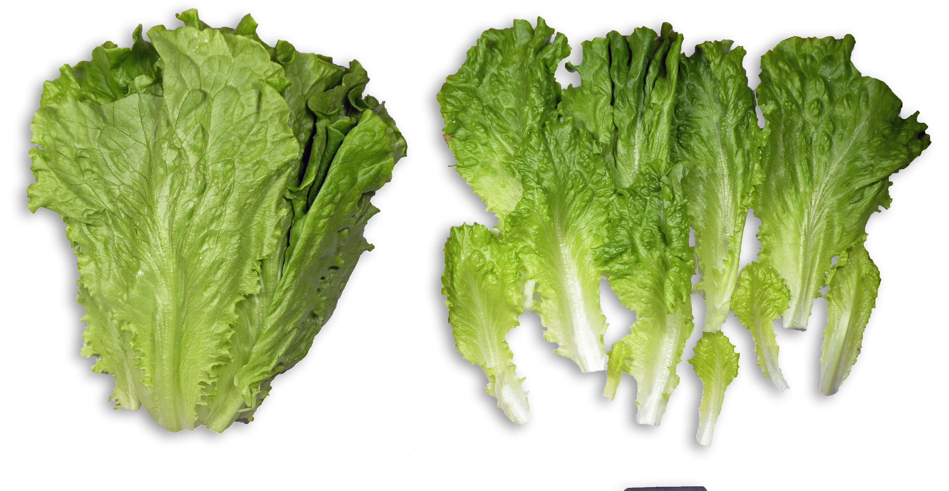
Day 7 Green Leaf in Old OTR Bag – out of Carton

Slide 8
Day 7 – Green Leaf
Both green leaf samples had red/brown stems and some brown lesions near the stems
Taste was good
Texture was crisp
Green Leaf Lettuce in Windham Packaging MAP Sleeves stored at 45-50°F for 7 days out of carton (top) and inside carton (bottom)

Slide 9
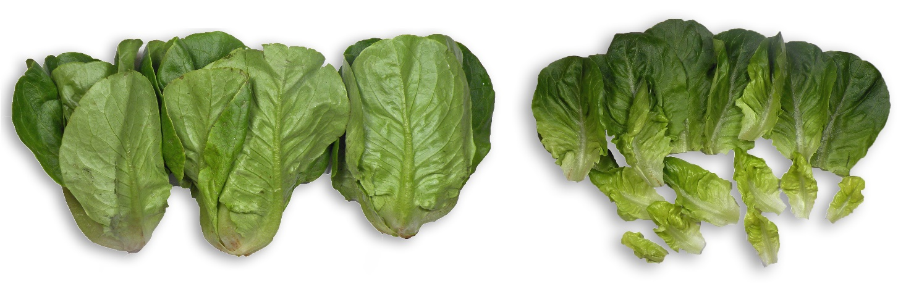
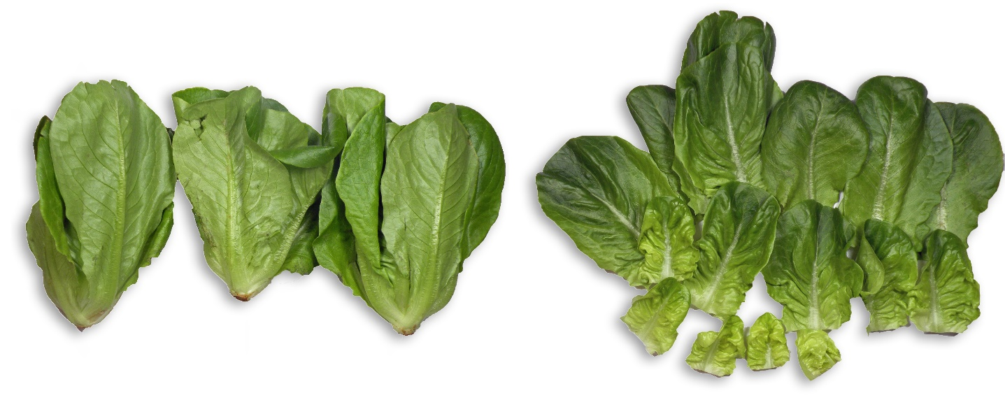
Day 7 – Baby Romaine
Both samples of baby romaine had red/brown stems and some brown lesions near the stems
There was some mildew (black spots) in the outer leaves
Taste was good
Texture was crisp
Baby Romaine in Windham Packaging MAP Sleeves stored at 45-50°F for 7 days out of carton (top) and inside carton (bottom)

Slide 10
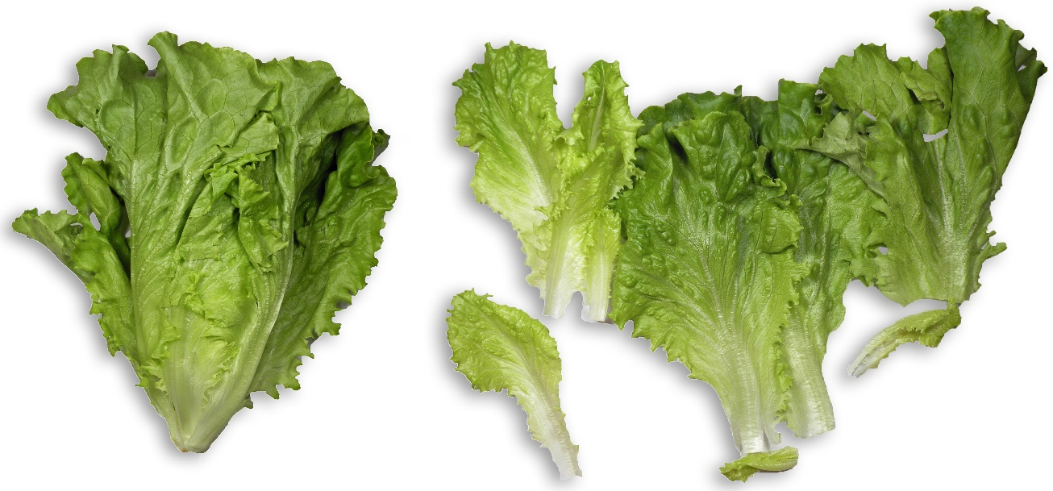
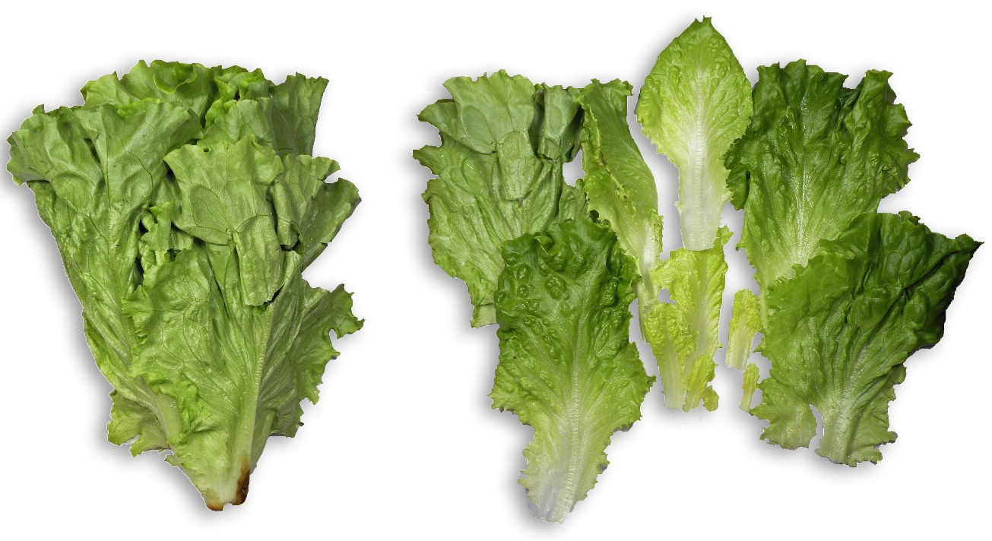
Day 9 – Green Leaf
Green leaf taste was good and fresh
Texture:
Inner leaves were crisp, some of the outer leaves drooped
1 leaf in each sample had mechanical damage that might lead to decay
Green Leaf Lettuce in Windham Packaging MAP Sleeves stored at 45-50°F for 7 days + 40°F for 2 days out of carton (top) and inside carton (bottom)

Slide 11
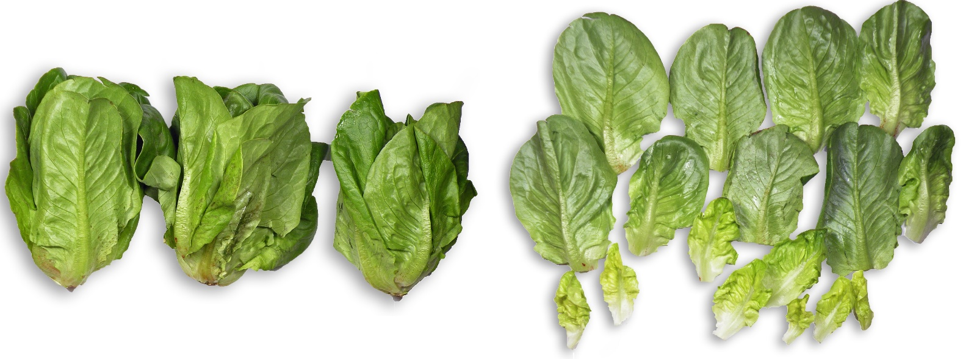
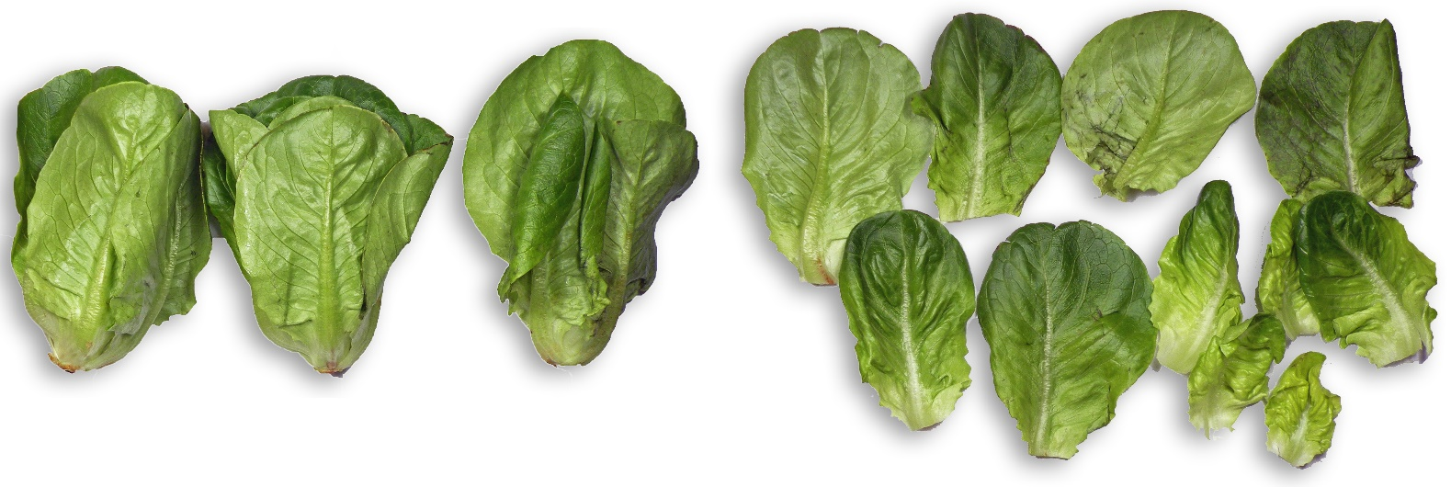
Day 9 – Baby Romaine
End of study for baby romaine
Romaine outside of carton
2 outer leaves had severe mildew
1 leaf was decayed
5 outer leaves had rust spots near the rib
Romaine inside carton
1 outer leaf had severe mildew
1 outer leaf had mechanical damage
1 leaf was decayed
Baby Romaine in Windham Packaging MAP Sleeves stored at 45-50°F for 7 days + 40°F for 2 days out of carton (top) and inside carton (bottom)

Slide 12
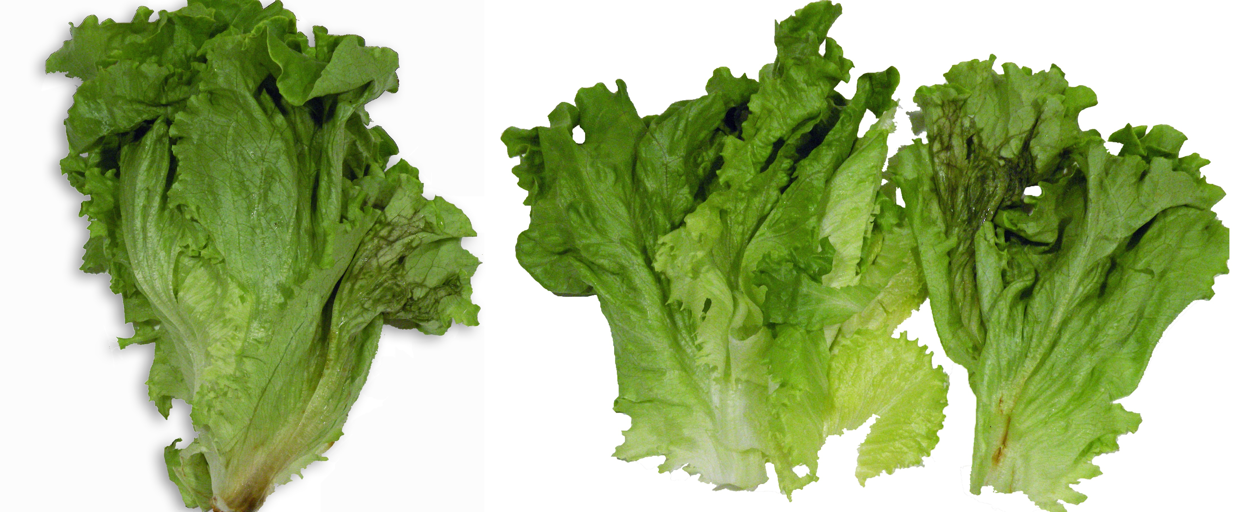
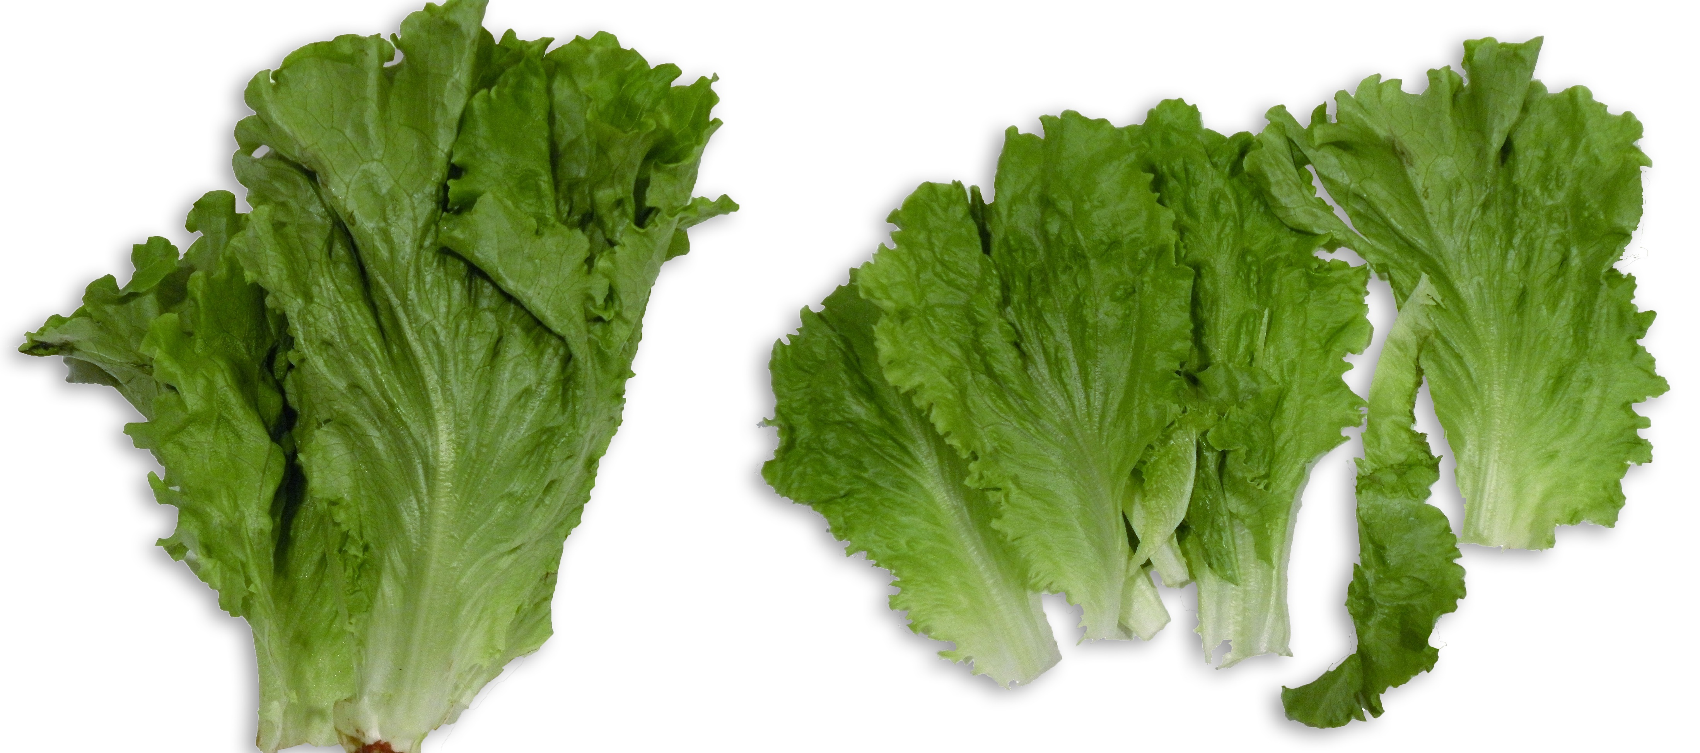
Day 12 –Green Leaf
Green leaf outside of the carton
1 outside leaf was decayed and looked very bad
1 brown rib in outside leaf near the stem
Outside leaves were limp but the inner leaves were crisp
Taste was very good; sweet and fresh
Green leaf inside the carton
The outer leaves were less crisp and the inner leaves were crisp
1 outer leaf was damaged and starting to rot
1 outer leaf was decayed
Taste was good; sweet and fresh
Green Leaf Lettuce in Windham Packaging MAP Sleeves stored at 45-50°F for 7 days + 40°F for 5 days out of carton (top) and inside carton (bottom)

Slide 13
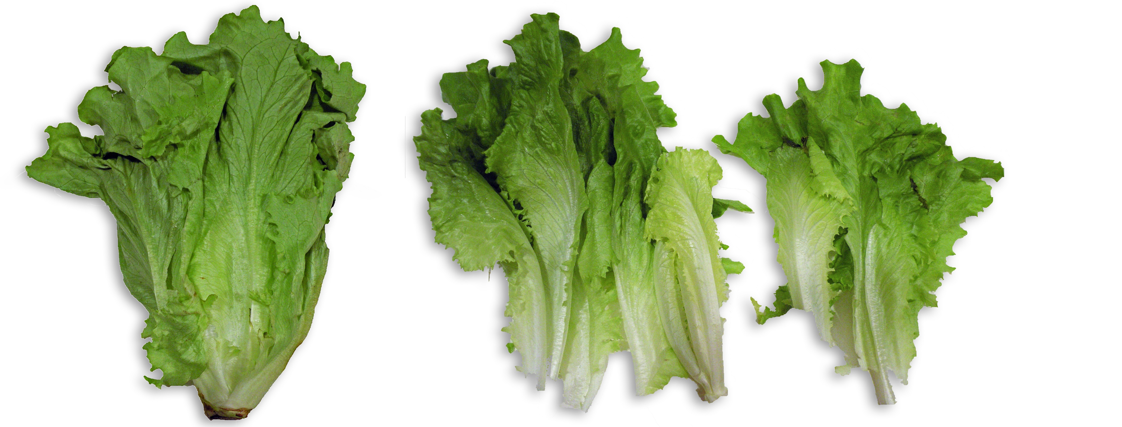
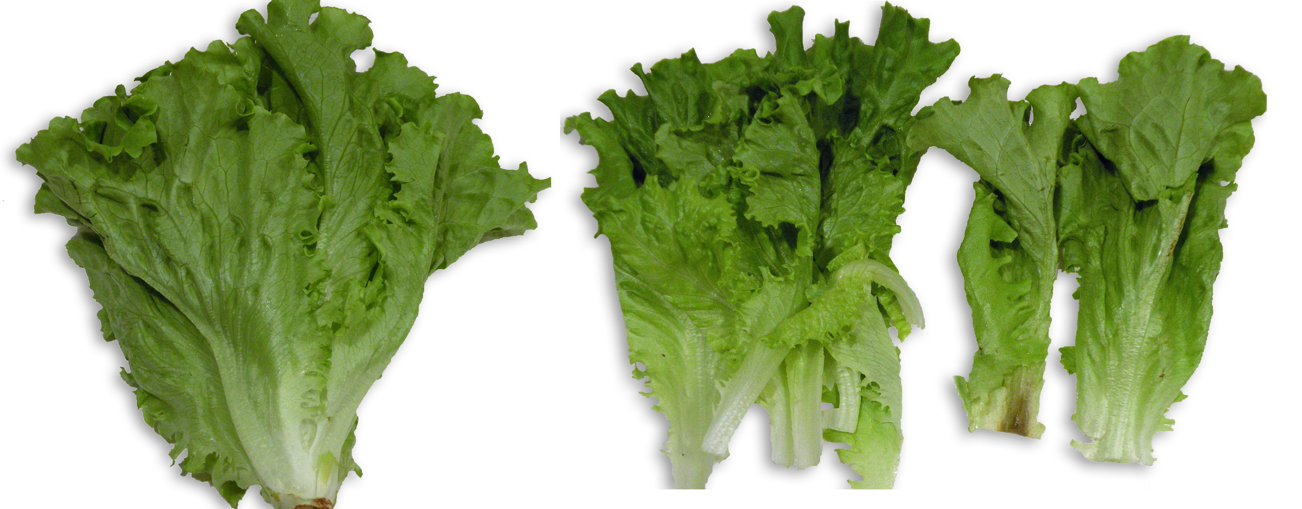
Day 14 – Green Leaf
Outside of carton
1 outer leaf was decayed (mostly in the rib)
Taste was good; fresh and sweet
Inside carton
2 leaves had mechanical damage
1 mechanically damaged leaf had a brown tip
Outer leaves were limp
Taste was sweet and fresh
Green Leaf Lettuce in Windham Packaging MAP Sleeves stored at 45-50°F for 7 days + 40°F for 7 days out of carton (top) and inside carton (bottom)

Slide 14
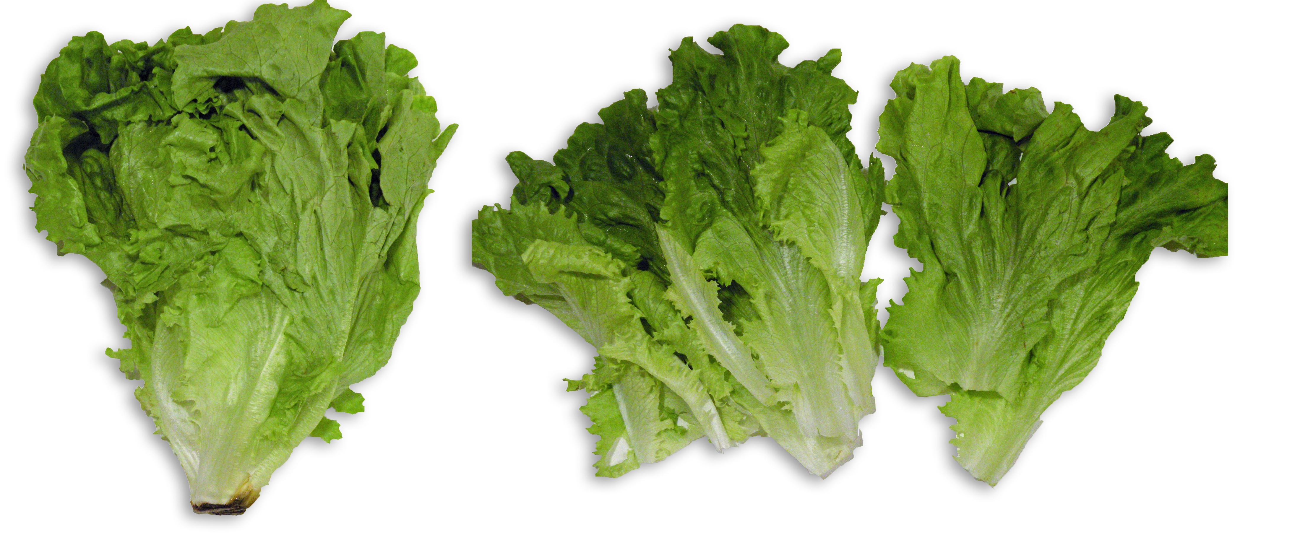
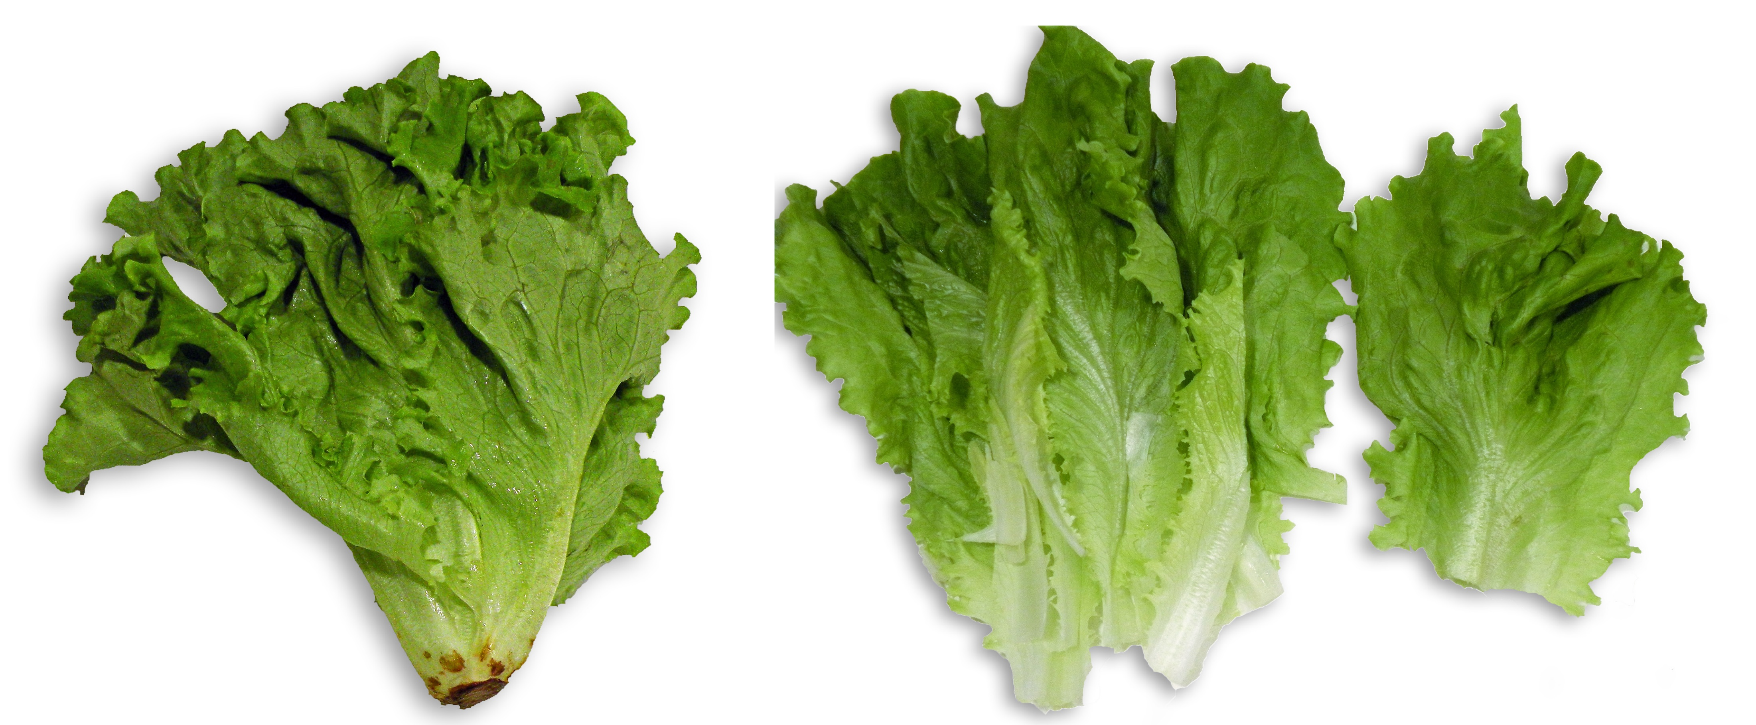
Day 17 – Green Leaf
Outside of carton
Outside leaves had damage from mold and mildew
Outside leaves were limp
Inner leaves were good
Taste was fresh and sweet
Inside carton
2 outer leaves had mold and mildew
Outside leaves were limp
Inner leaves were good
Taste was fresh and sweet
Green Leaf Lettuce in Windham Packaging MAP Sleeves stored at 45-50°F for 7 days + 40°F for 10 days out of carton (top) and inside carton (bottom)

Slide 15
Materials and Methods
Baby romaine and green leaf heads were grown and harvested on 12/26/18 at Springworks Farm at 70°F. Initial quality was observed and recorded.
The harvested product was moved to a cooler (34-36°F). The product was packaged in Windham Packaging MAP bags (baby romaine) and sleeves (green leaf) in the cooler and held at 34-36°F until 12/27/18.
The product was packed into coolers and transported to the laboratory at Windham Packaging, Windham, NH.
Product was weighed and placed in trays or into vented cartons and kept in 50°F for 7 days to simulate warehouse and retail conditions.
Packages were then moved to 40°F for the remainder of the study.

Slide 16
Procedures: Quality Testing
Weight was checked on days 0, 7, 9, 12, 14, and 17 using a digital scale
Expressed as weight loss (%)
Quality observations such as decay, yellowing, mold/mildew, mechanical damage, stem color, browning, taste and off-odor were observed.
Temperature of lettuce was checked with an infrared thermometer while the product was both inside and outside of the bags.
Headspace readings inside packages were checked using a gas analyzer
Shelf life studies were done on each sample during each test day

